Slide 2
Calculation of Cyclomatic Complexity
V(G)=e-n+2P
Where e: number of edges of a graph G
n: number of nodes of a graph G
P: number of connected components

Slide 3
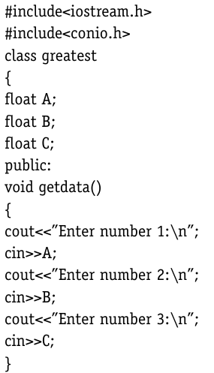
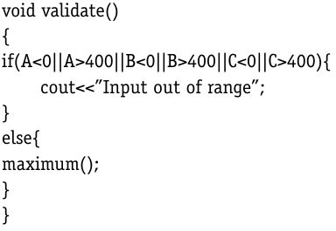
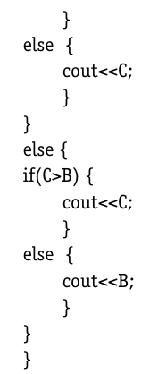
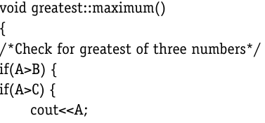

Slide 4
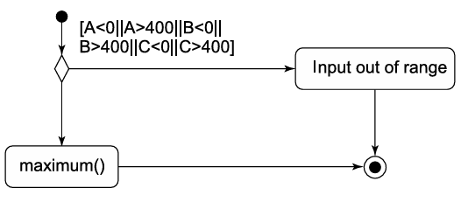



Slide 5
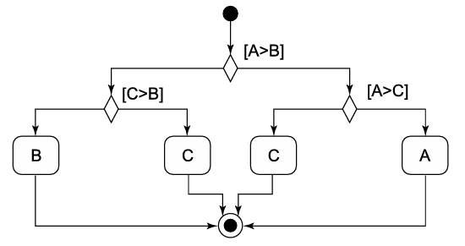


Slide 6
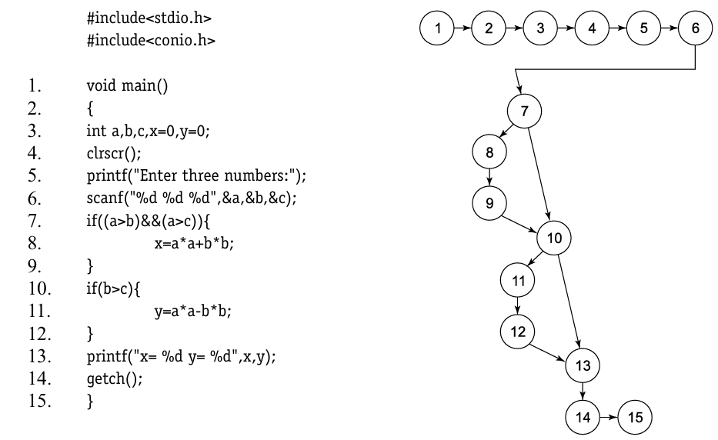

Slide 7
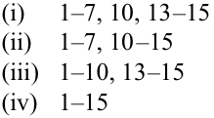
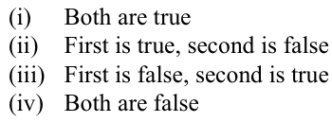
All paths
Statement 1-15
Branch 1-15
1-7, 10, 13-15
Condition 1-15
1-10, 13-15
1-7, 10-15
1-7, 10, 13-15

Slide 8

All paths

Slide 9

Basis Paths?

Slide 10
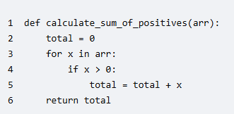
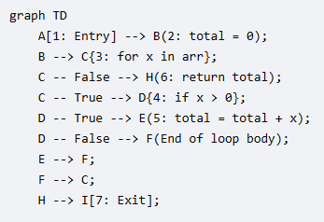

Slide 11
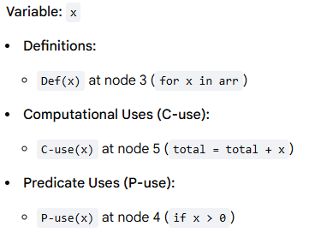
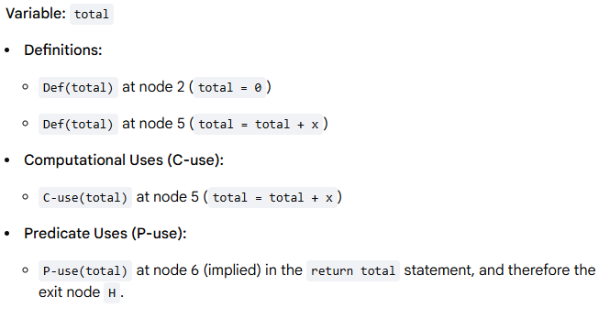

Slide 12



Slide 13
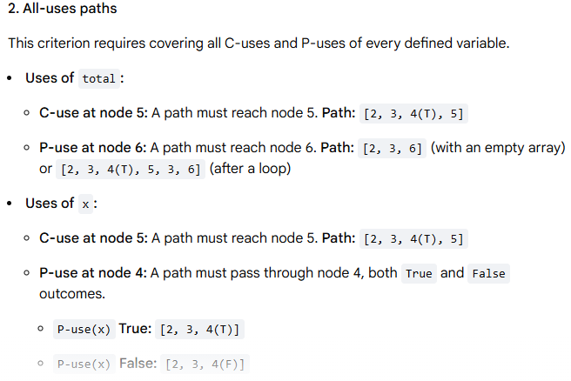

Slide 14
